Slide 1
MATH 323
Graph Theory
Cr. 3
Lecture 1
March 18, 2015
Dr. Bhadra Man Tuladhar
MATH 323 Graph Theory Lec. 1

Slide 2

Graph Theory
Fundamental Concepts
Trees
Planar Graphs
Graph Coloring
Matching
MATH 323 Graph Theory Lec. 1

Slide 3
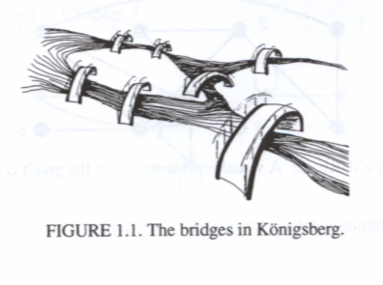
Fundamental Concepts
Examples:
Königsberg Bridge
(1700)
To walk across a route that crossed each of these bridges exactly once.
In 1736 Leonhard Euler gave a negative proof.
MATH 323 Graph Theory Lec. 1

Slide 4

Examples (Contd.)
Four Color Map
(1852 – DeMorgan)
Four is the maximum number of colors required to color any map where bordering regions are colored differently.
In 1976 Appel and Haken proved the conjecture positively.
MATH 323 Graph Theory Lec. 1

Slide 5
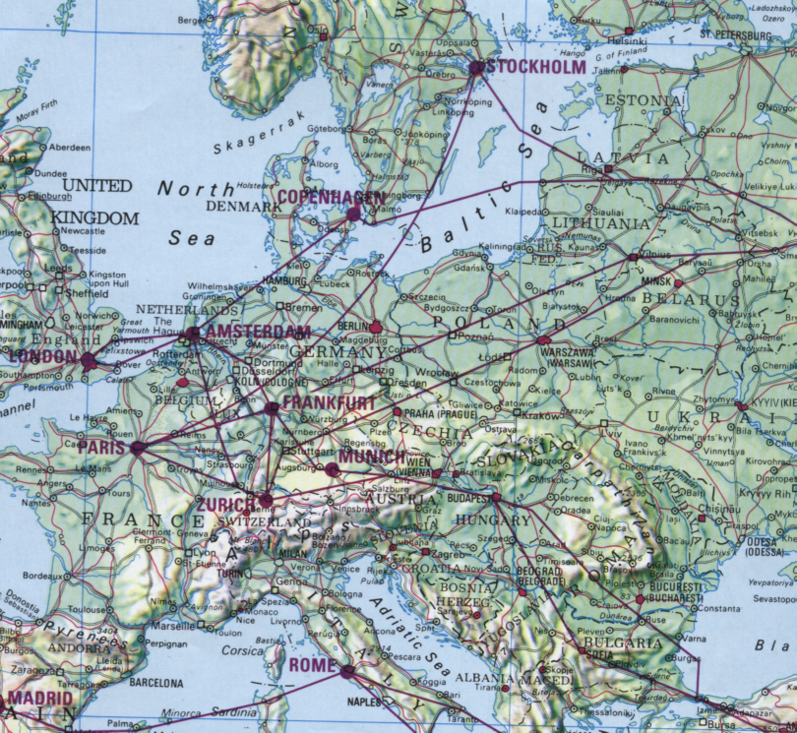
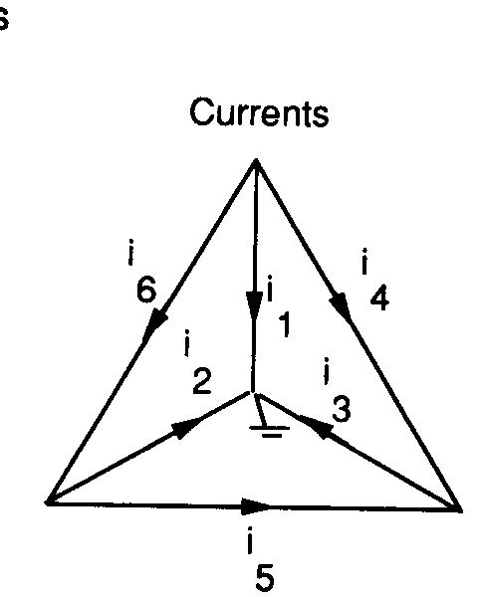

More Examples
Air Route
Electrical Circuit
MATH 323 Graph Theory Lec. 1

Slide 6
Examples (Contd.)
Interior angles of a polygon
Polygon No. of sides ΣInterior angles
Triangle 3 π
Rectangle 4 2 π
Pentagon 5 3 π
Hexagon 6 4 π
n-sided n
(n-2) π
MATH 323 Graph Theory Lec. 1

Slide 7
Examples (Contd.)
Euler Formula
Figure Vertex Edge Face
(V) (E) (F)
3-pyramid 4 6 4
4-pyramid 5 8 5
Cube 8 12 6
Relation: V + F = E + 2
MATH 323 Graph Theory Lec. 1

Slide 8
Some Definitions
Graph – A graph G(V,E) with n vertices and m edges consists of
a vertex set V(G) = (v₁, v₂, …, v_{n}) and
an edge set E(G) = (e₁, e₂, …, 2_{m}), where each edge consists of two (possibly equal) vertices called endpoints.
MATH 323 Graph Theory Lec. 1

Slide 9
Visual Representation
1
3
2
4
5
6
8
7
Vertex set, V = {1, 2, 3, 4, 5, 6, 7, 8}
Edge set, E = {{1,4}, {1,5}, {2,3},{2,5},
{2,7}, {3,6}, {4,6}, {4,7}, {7,8}}
MATH 323 Graph Theory Lec. 1

Slide 10
Types of Graphs
By replacing set E with a set of ordered pairs of vertices, we obtain a directed graph, or digraph.
MATH 323 Graph Theory Lec. 1

Slide 11
Types of Graph
If we allow repeated elements in the edge set, we obtain multigraph.
MATH 323 Graph Theory Lec. 1

Slide 12
Types of Graph
By allowing edges to connect a vertex to itself (loops), we obtain a pseudograph.
MATH 323 Graph Theory Lec. 1

Slide 13
Types of Graph
Allowing the edges to be arbitrary subsets of vertices gives hypergraphs.
A hypergraph with 6 vertices and 5 edges
MATH 323 Graph Theory Lec. 1

Slide 14
Types of Graph
By allowing V or E to be infinite set, we obtain infinite graphs.
In this chapter we will focus on finite, simple graphs: without loops or multiple edges.
MATH 323 Graph Theory Lec. 1

Slide 15
Exercise
Draw the graph G(V, E) with
1. Vertex set V = {a, b, c, d, e, f}
Edge set E = {{a, d}, {a, f}, {b, c,}, {b, f}, {c, e}}
Vertex set V ={v₁, v₂, v₃, v₄, v₅}
Edge set E = {{v₁, v₁}, {v₂, v₃}, {v₂, v₄},{v₃, v₂}, {v₁, v₄}, {v_{5,} v₄}}
Describe the graph :
v₁
v₂
v₅
v₄
v₃
MATH 323 Graph Theory Lec. 1

Slide 16
Exercise (Contd.)
C. Ten people are seated around a circular table. Each person shakes hands with everyone at the table except the person sitting directly across the table. Draw a graph that models this situation.
MATH 323 Graph Theory Lec. 1

Slide 17
Exercise (contd.)
D. There are nine basketball teams:
Florida (F), Georgia (G), Clemson (C), North Carolina (N), State (S), Duke (D), Virginia (V) Maryland (M) and Wake (W).
At a certain point in midseason,
C has played D*, G D has played C*, S, W
F has played N*, V G has played C, M
M has played G, N N has played F*, M, W
S has played D, V* V has played F, S*
W has played D, N
Exercise * indicates that teams have played each other twice. Draw a multigraph that models this situation.
MATH 323 Graph Theory Lec. 1

Slide 18
Some Notations & Definitions
An edge is denoted {u, v} or simply as uv.
The order of a graph G is the cardinality of its vertex set V.
The size of a graph G is the cardinality of its edge set E.
Given two vertices u and v, if uv∈E, then u and v are said to be adjacent. If uv∉E, u and v are nonadjacent.
If an edge e has a vertex v as an endpoint, then u and e are incident.
The neighborhoods of a vertex v, denoted by N(v), is the set of vertices adjacent to v: N(v) = {x ∈V | vx ∈E}
MATH 323 Graph Theory Lec. 1

Slide 19
More definitions
The degree of v, denoted by deg(v), is the number of edges incident with v. In simple graphs, this is the same as the cardinality of the neighborhood of v.
The maximum degree of a graph G, denoted by Δ(G), is defined to be
Δ(G) = max{deg(v) | v ∈ V(G)}
The minimum degree of a graph G, denoted by δ(G), is defined to be
δ(G) = min{deg(v) | v ∈ V(G)}
MATH 323 Graph Theory Lec. 1

Slide 20
Example
1
3
2
4
5
6
8
7
Vertices 1 and 5 are adjacent, vertices 1 and 2 are nonadjacent.
deg(3) = 2, deg(7) = 3, N(4) = {1, 6, 7}, Δ(G) = 3, δ(G) = 1.
MATH 323 Graph Theory Lec. 1

Slide 21
First Theorem of GT
Theorem 1.
In a graph G, the sum of the degrees of the vertices is equal to twice the number of edges.
Alternatively, the number of vertices with odd degree is even.
MATH 323 Graph Theory Lec. 1

Slide 22
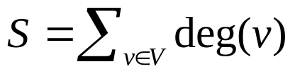
Proof
Let . Notice that in counting S, we count each edge exactly twice.
Thus S = 2|E| (the sum of the degrees is twice the number of edges).
Since S is even, it must be that the number of vertices with odd degree is even.
(Also known as Handshaking Lemma.
If several people shake hands, then the number of hands shaken is even)
MATH 323 Graph Theory Lec. 1

Slide 23
Course of Study
Fundamental Concepts
  Definitions and Examples
  Paths
  Vertex
  Isomorphism
  Subgraphs
  Types of Graphs
  Some applications
MATH 323 Graph Theory Lec. 1

Slide 24
Course of Study
Trees
  Basic Properties
  Spanning Trees
  Optimization
  Counting trees
  Digraphs
MATH 323 Graph Theory Lec. 1

Slide 25
Course of Study
Planar Graphs
  Definitions and examples
  Euler’s Formula
  Characterization
  Parameters
MATH 323 Graph Theory Lec. 1

Slide 26
Course of Study
Graph Coloring
  Definitions
  Vertex coloring
  Bounds
  The four color problem
  Chromatic graphs
MATH 323 Graph Theory Lec. 1

Slide 27
Course of Study
Matching
  Definitions
  Maximum matching
  Hall’s matching conditions
  Perfect matching
MATH 323 Graph Theory Lec. 1

Slide 28
More Next Time
MATH 323 Graph Theory Lec. 1

